Slide 1
Numerical Python with Linear Algebra

Slide 2
Introduction to NumPy
- NumPy is a library for numerical computations in Python
- Provides multi-dimensional arrays, matrix operations, and linear algebra functions
- Used in ML and Data Science for efficient computations

Slide 3
Creating and Manipulating Arrays
1. 1D Arrays (Vectors): np.array([1, 2, 3])
2. 2D Arrays (Matrices): np.array([[1, 2], [3, 4]])
3. Special Matrices: np.zeros(), np.eye() (Identity Matrix)
4.Stack arrays:
Combining multiple features
Merging datasets
Creating feature matrices
Vectorized Operations (Ex: Images, Euclidean)
Advanced Numpy: reshaping/flattening and selection

Slide 4
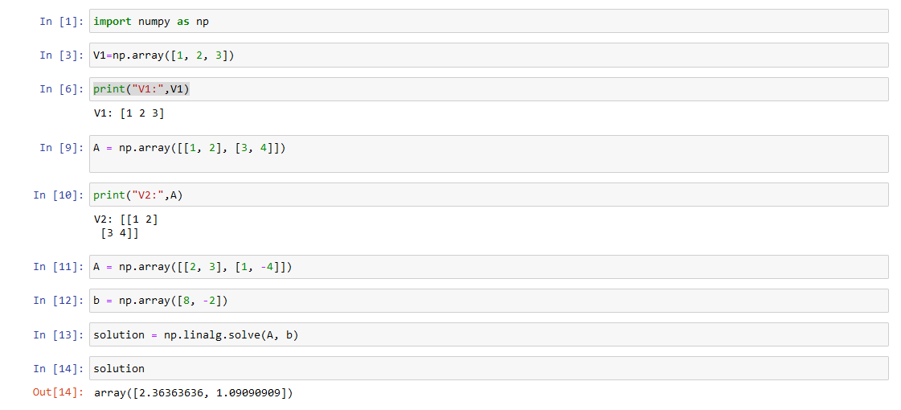

Slide 5
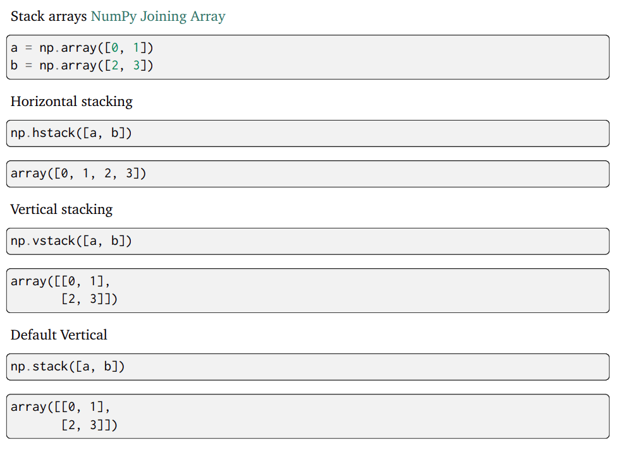

Slide 6
Solving Linear Equations
Example:
Solve: 2x + 3y = 8, x - 4y = -2
Solution using NumPy:
A = np.array([[2, 3], [1, -4]])
b = np.array([8, -2])
solution = np.linalg.solve(A, b)

Slide 7
Pandas DataFrames in Machine Learning
Understanding Data Manipulation & Analysis in ML using Pandas

Slide 8
What is Pandas?
Pandas is a Python library used for data manipulation and analysis. It provides DataFrames, a powerful tabular data structure similar to an Excel sheet or SQL table.
A DataFrame is a two-dimensional labeled data structure in Python provided by the Pandas library. It is similar to a table in a database or an Excel spreadsheet.
Pandas is crucial for data preprocessing in ML.
Helps in cleaning, transforming, and analyzing data.
Essential for feature engineering and model preparation.

Slide 9
Creating a Pandas DataFrame
Example:
import pandas as pd
data = {'Name': ['Alice', 'Bob', 'Chand'], 'Age': [25, 30, 35]}
df = pd.DataFrame(data)
print(df)

Slide 10
Loading Data into a DataFrame
Pandas supports multiple file formats:
- CSV: df = pd.read_csv('data.csv')
- Excel: df = pd.read_excel('data.xlsx')

Slide 11
Exploring Data
- df.head() # First 5 rows
- df.tail() # Last 5 rows
- df.info() # Data types and non-null values
- df.describe() # Summary statistics

Slide 12
Selecting & Filtering Data
Selecting Columns:
df['Age']
Filtering Rows:
df[df['Salary'] > 60000]

Slide 13
Data Preprocessing for ML
- Drop categorical columns: df.drop('Name', axis=1)
- Normalize salary:
from sklearn.preprocessing import MinMaxScaler
scaler = MinMaxScaler()
df['Salary'] = scaler.fit_transform(df[['Salary']])

Slide 14
Training a Machine Learning Model
from sklearn.linear_model import LinearRegression
model = LinearRegression()
model.fit(X_train, y_train)
predictions = model.predict(X_test)

Slide 15
Role of NumPy and Pandas in Dataset Preparation
Using NumPy
Convert data into arrays
Perform mathematical operations
Normalize/scale data
Prepare matrices for ML models
Using Pandas
Load datasets (CSV, Excel)
Handle missing values
Filter and group data
Encode categorical variables
Create features

Slide 16
import numpy as np
from sklearn.linear_model import LinearRegression
study = np.array([2,4,6,8])
sleep = np.array([7,6,5,4])
X = np.column_stack((study,sleep))
y = np.array([50,60,70,80])
model = LinearRegression()
model.fit(X,y)
prediction = model.predict([[5,6]])
print("Predicted Score:",prediction)
Predicted Score ≈ 65

Slide 17
# Scikit-Learn (Machine Learning Library)
# Example: Linear Regression
from sklearn.linear_model import LinearRegression
import numpy as np
# Input feature (Years of work experience)
X = np.array([1, 2, 3, 4, 5]).reshape(-1, 1)
# Target output (Salary in Lakhs)
y = np.array([2, 4, 5, 8, 9])
# Create Linear Regression model
model = LinearRegression()
# Train the model
model.fit(X, y)
# Predict salary for 6 years of experience
prediction = model.predict([[6]])
print("Predicted Salary:", prediction)
Predicted Salary: [10.6]

Slide 18
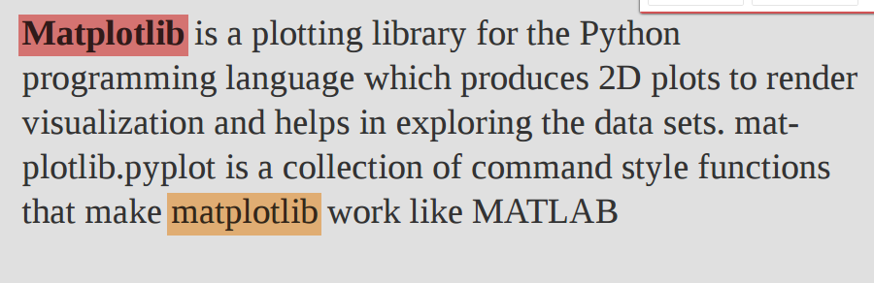
Data visualization and plotting

Slide 19
Scatter Plot – Visualizing Relationship Between Features
A scatter plot is used to show relationships between two numerical features.
Line Plot – Model Performance Over Epochs
A line plot is useful for tracking model training progress over time.
Histogram – Understanding Data Distribution
A histogram shows the frequency distribution of a feature.
Box Plot – Detecting Outliers
A box plot (or box-and-whisker plot) helps in detecting outliers and spread of numerical data.
Heatmap – Correlation Between Features
A heatmap shows feature relationships using colors.
Confusion Matrix – Evaluating Classification Models
A confusion matrix helps analyze model performance in classification tasks.

Slide 20
Mathematical and Machine Learning Packages in Python

Slide 21
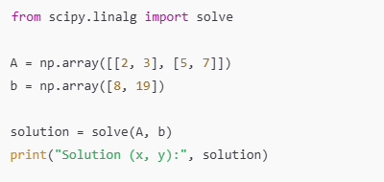
Python provides many libraries for mathematical computations and machine learning.
SciPy
A scientific computing library built on NumPy.
Used for numerical integration, optimization, signal processing, etc.

Slide 22
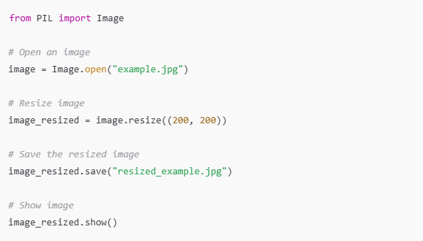
PIL (Python Imaging Library)
Used for image processing tasks like opening, manipulating, and saving images.
Pillow is the modern version of PIL.

Slide 23
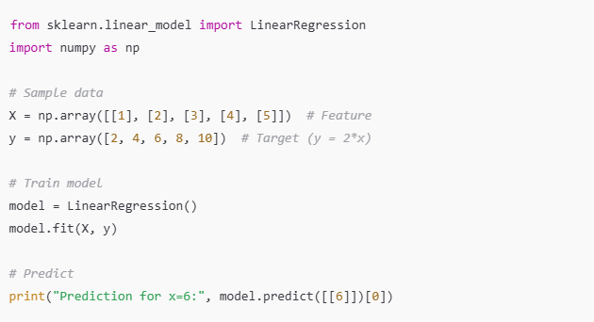
Scikit-learn
A powerful ML library for classification, regression, clustering, and more.
Contains preprocessing tools, ML models, and evaluation metrics.

Slide 24
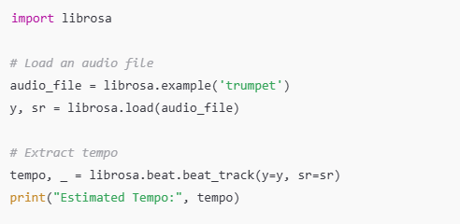
Librosa
A library for audio analysis and music information retrieval.
Used in speech and sound processing applications.

Slide 25
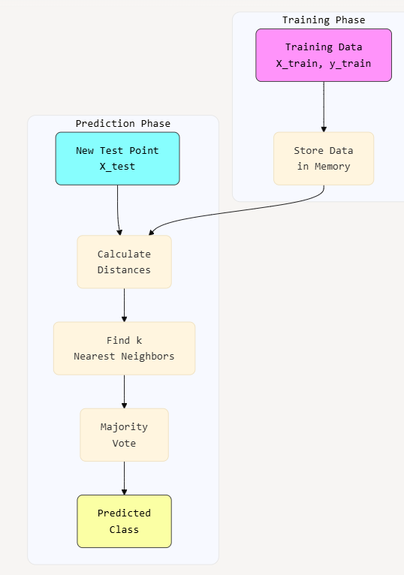
KNN Classifier

Slide 26
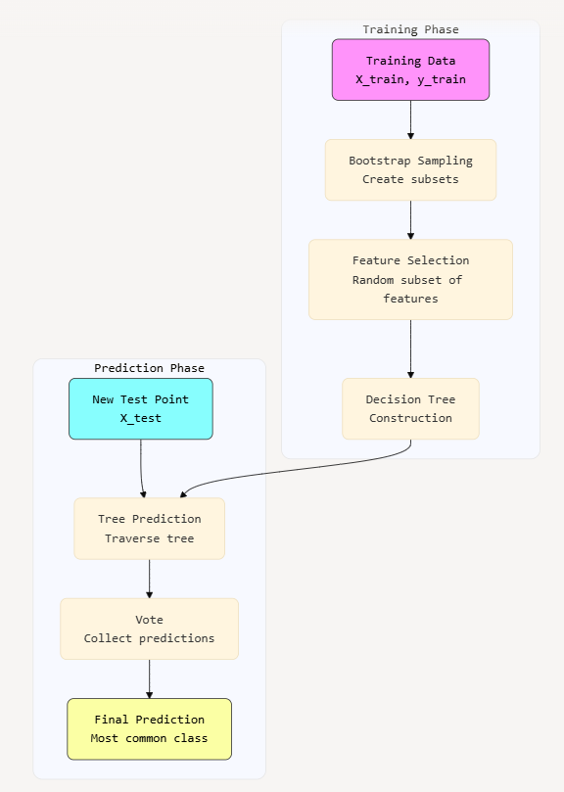
Random Forest

